Slide 1

Database Connectivity - DAOs
M2-D6

Slide 2
Objectives
DAO (Data Access Object) Pattern
JDBC
SpringJDBC
Making Connections
Executing SQL Statements (SELECT)
Parameterized Queries
Getting Results

Slide 3
DAO Pattern
The Data Access Object (DAO) design pattern encapsulates the details of persistent storage inside of classes whose only role is to store and retrieve data.
DAOs usually perform CRUD operations on domain objects (also called Business Objects).
Create
Read
Update
Delete
DAO pattern makes code loosely coupled
Isolating data access code inside of DAOs decouples the rest of the application from the details of persistence
Relational databases are often used for persistent storage, but other technologies could be used such as the filesystem, NoSQL database, web service, etc
Isolates the code changes that need to be made in the event of a table schema change.

Slide 4
Parts of the DAO Pattern
The DAO Pattern breaks the responsibility of data access into 3 parts.
Data Object - a simple data object (POJO) often called a domain or business object. This data object will act as a data type that represents on row of data returned by the queries. It often matches the columns of the table being accessed.
DAO Interface - An interface that defines methods for the CRUD operations that the implementation class must provide. These methods will generally use either the DAO Domain Object or simple types (String, long, int, etc) as return types and arguments.
Implementation Class (JDBCDao) will implement the DAO Interface, take a DataSource as a constructor argument, and encapsulate the interactivity with the data source.

Slide 5
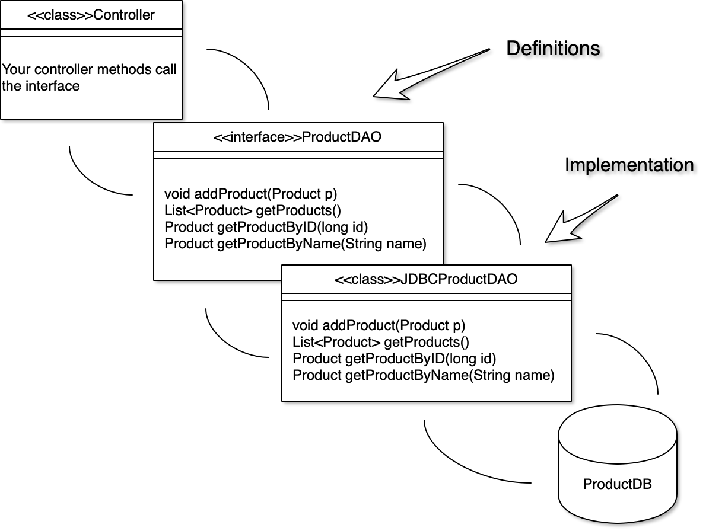
Sample:
Controller or Service Layer
DAO Layer

Slide 6
UI Layer
Service Layer
Data Access Layer
Menu
Implements HomeDAO
Service Classes (logic and rules)
HomeDAO <interface>
HomeJDBCDAO <class>
SQL
Database
CLI -
Home APP
RealtorDAO <interface>
RealtorJDBCDAO <class>
SQL
Web
ZillowDAO <interface>
ZillowClientDAO <class>
Web API
zillow.com
Mobile
App

Slide 7
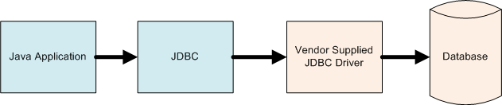
JDBC
Java Database Connectivity (JDBC) is a library that allows Java applications to access SQL databases in a standard way. The vendor of the database provides a Driver that implements an interface that JDBC is expecting. Java Applications then use the JDBC library and JDBC calls the vendor supplied driver to access the specified database. This allows Java Applications to be written in a generic fashion without regard to what SQL database they are using.

Slide 8
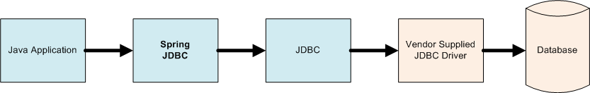
Spring JDBC
SpringJDBC is a framework that provides an abstraction for JDBC making it easier to use.
SpringJDBC provides a consistent way to create queries, handle results, deal with exception, and automatically provides transactions.
Using SpringJDBC, our Java Application will use the SpringJDBC Framework, which will utilize JDBC to call the Vendor Supplied JDBC Driver to access the Database.
https://www.tutorialspoint.com/springjdbc/index.htm

Slide 9
A Connection Pool works like a library of connections. The Connection Pool makes multiple connections to the database and keeps them open. When an application needs a connection it “checks one out” from the pool. When it is finished with it it returns it to be reused. This reduces the overhead of a new connection each database access is needed. Multiple Applications can use the same Connection Pool, allowing for fewer overall connections.
Application Requests a Connection
Connection
Database
Application
Connection
2. Connection returned from pool
Connection
3. When Connection is closed by Application it is returned to the Pool
Connection
Connection Pool

Slide 10
Making a Connection
A Connection String is like an address (URL) to a web site only used to connect to a database. It includes details on what vendor driver to use, where the database is located on a network, the name of the database to connect to, and the credentials (user id / password).
BasicDataSource dvdstoreDataSource = new BasicDataSource();
dvdstoreDataSource.setUrl("jdbc:postgresql://localhost:5432/dvdstore");
dvdstoreDataSource.setUsername("postgres");
dvdstoreDataSource.setPassword("postgres1");
BasicDataSource - The org.apache.commons.dbcp2.BasicDataSource provides the ability to make a database connection and a Connection Pool.
The setUrl takes a connection string as an argument: jdbc:postgresql://localhost:5432/dvdstore
jdbc:postgresql:// tells the DataSource to use JDBC with the PostgreSQL Vendor Driver
localhost:5432 tells the DataSource the location of the database on a network, in this case the same computer.
dvdstore is the name of the database which to connect
setUsername() and setPassword() methods set the username and password to use when connecting to the database

Slide 11
Executing SQL Statements
JDBCTemplate allows for the execution of queries using the DataSource.
JdbcTemplate jdbcTemplate = new JdbcTemplate(datasource);
Queries that return results, like SELECT, use
SqlRowSet rs = jdbcTemplate.queryForRowSet(sql, params1...paramsN)

Slide 12
Parameters
Even though SQL Statements are created as Strings in Java, values used in a query should not be concatenated, unless the source of the value is a known as safe. A literal value is safe, but arguments passed to a method are always unsafe! To allow for variable data, the methods that jdbcTemplate provides can take parameters. Parameters are represented in the SQL String with a ?, and passed as a list to the jdbcTemplate methods in the same order as the ? appear in the query.
DANGEROUS - Concatenation
String sql = “SELECT * FROM actor WHERE first_name = “ + firstName + “ AND last_name = “ + lastName;
Concatenating Strings to create SQL Queries can open an application to a SQL Injection attack, which is a critical security vulnerability that has been responsible for some of the largest data breaches in history.
SAFE - Parameters
String sql = “SELECT * FROM actor WHERE first_name = ? AND last_name = ?”;
jdbcTemplate.queryForRowSet (sql, firstName, lastName );

Slide 13
Getting Results
The JDBCTemplate queryForRowSet() method returns a SqlRowSet object, which will contain the results of the query. Each row is returned as an entry in a Set, which can be looped through using next(). Each time next() is called it moves to the next row in the set. next() returns true/false if more data exists. next() must always be called once to access the first row. Data can be accessed for a row by using the provided getters with column name returned in the query.
SqlRowSet results = jdbcTemplate.queryForRowSet(sql, filmid);
while (results.next()) {
String filmTitle = results.getString("title");
int releaseYear = results.getInt("release_year");
}
Detailed Description of using Next() in Cheatsheets

